Slide 1
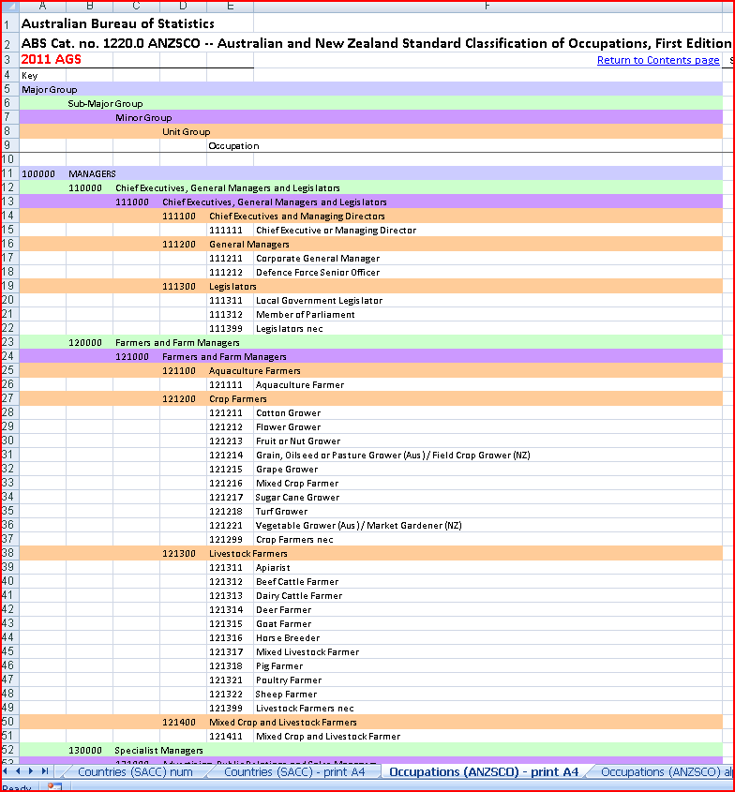
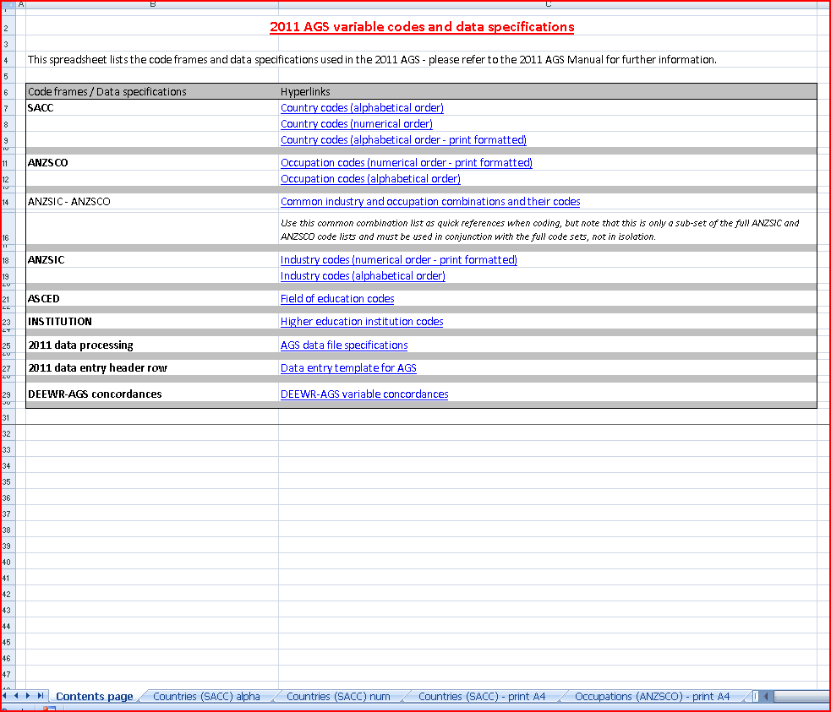
AGS
Documentation

Slide 2
AGS Documentation
AGS Manual
Manual Spreadsheet
Code of Practice
Pre-SOC
Post-SOC
Advance round population summary
AGS report

Slide 3
AGS Manual
Updated for each round (key changes highlighted in red)
Due for distribution first day of round (1 Oct and 1 April)
Includes a summary main steps of AGS operations
Covers all major aspects of the AGS from policy and practice to population, distribution and coding

Slide 4
Manual Spreadsheet
Accompanies AGS Manual
Codes
SACC
ANZSCO
ANZSIC
ASCED
Institution

Slide 5
Manual Spreadsheet
Variable dictionary
Variable names
Codes and value labels
Place in data file
Comments
Data file header row (spreadsheet)
DEEWR-AGS concordances

Slide 6
Code of Practice
Updated in 2010 after sector consultation
FAQ on START web site
Key: unqualified comparisons
Key: response rate and data release
Key: exempted users

Slide 7
Pre-Survey Operations Checklist (Pre-SOC)
Accompanies AGS Manual
Useful for new Survey Managers
A guide through the planning, fieldwork and processing phases of the AGS
Also a record of what you did

Slide 8
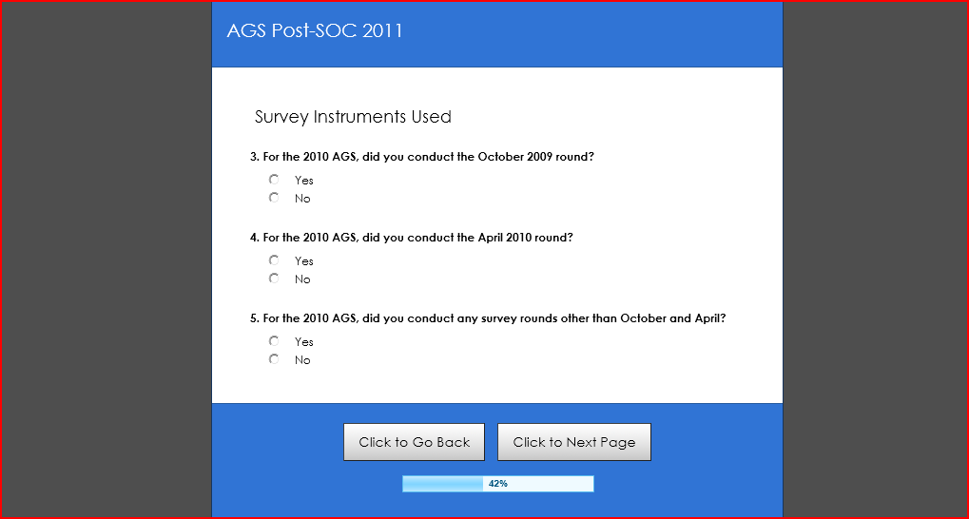
Post-Survey Operations Checklist (Post-SOC)
New – an online questionnaire
Will form a record of how the data were gathered
Will feed into the new annual AGS Report

Slide 9
Post-Survey Operations Checklist (Post-SOC)
Simple set of questions about how your institution conducted the AGS
Rounds, instruments, distribution
Phone surveying
Methods and incentives
Data preparation and processing

Slide 10
Advance Round Population Summary
Completed and returned at the start of each round
Due by referent date
Intended to establish approximate institutional survey population at start of the AGS round
For later comparison to final response and DEEWR course completions figures

Slide 11
AGS Report
A report of the conduct of the AGS to be distributed with AGS reports and data files
‘New Model’ development (discussed in the April 2011 manual)
Will allow users to make judgements about how an institution gathered its data and could be used to include or exclude an institution's data in certain analyses or uses
Reconcile eventual institutional responses with their Advance Round Population Summary and relevant DEEWR course completions figures
Post-SOC will feed into AGS report

